Slide 1

-ABC CINEMA-
Group - B

Slide 2

Introduction
Built using Java servlets, Apache tomcat, MySQL WorkBench
Goal is to provide users with an easy and convenient way to browse and experience easy movie experience

Slide 3
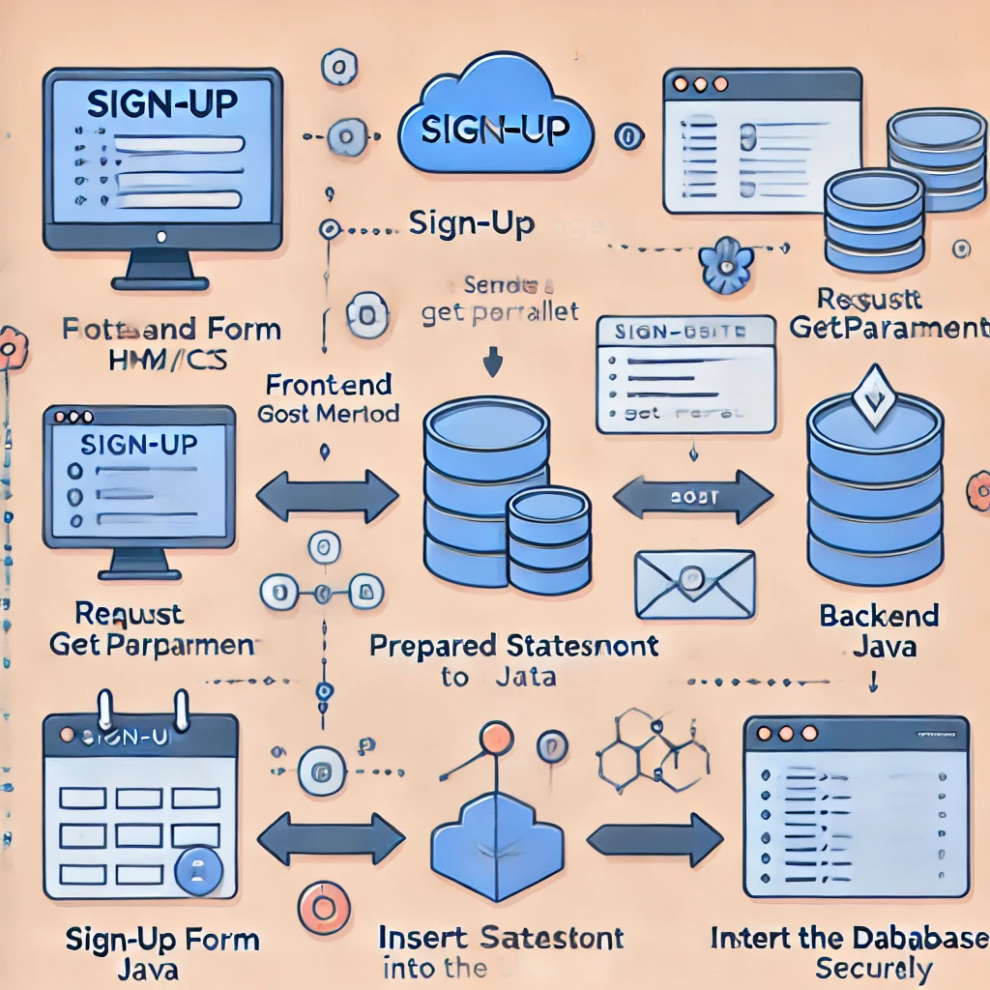
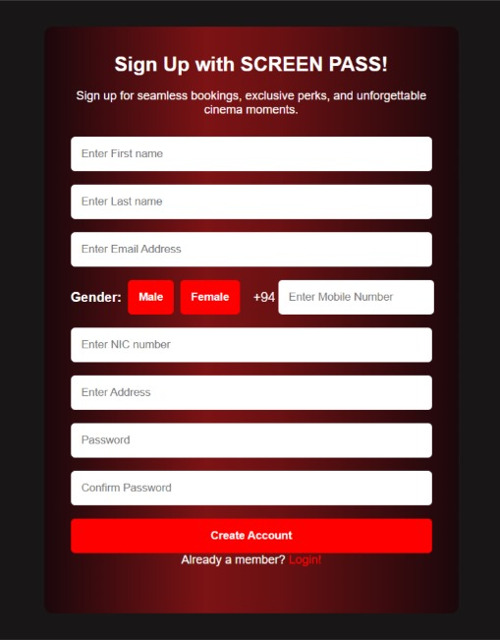
Signup Page
How data flows from front-end to backend and finally into the database

Slide 4
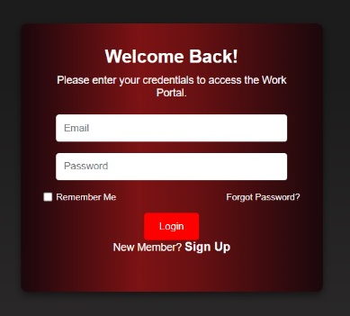
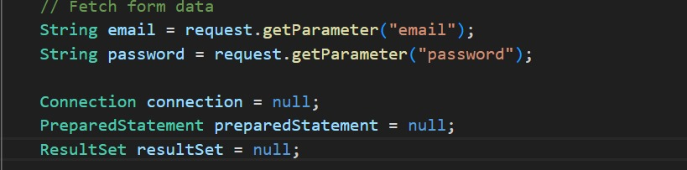
Login Page
Logical Flow
Input -> Processing -> Output

Slide 5
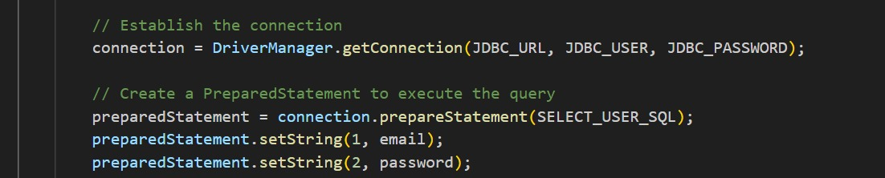
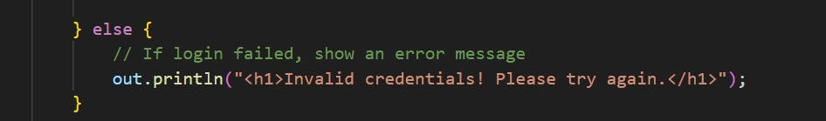
Login Page
Role of sessions in user authentication
Error Handling

Slide 6
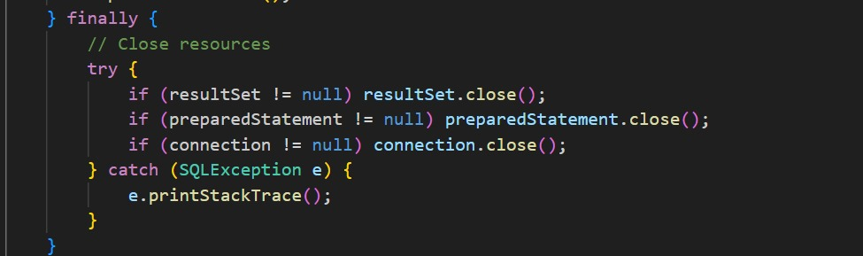
Login Page
Importance of resource management

Slide 7
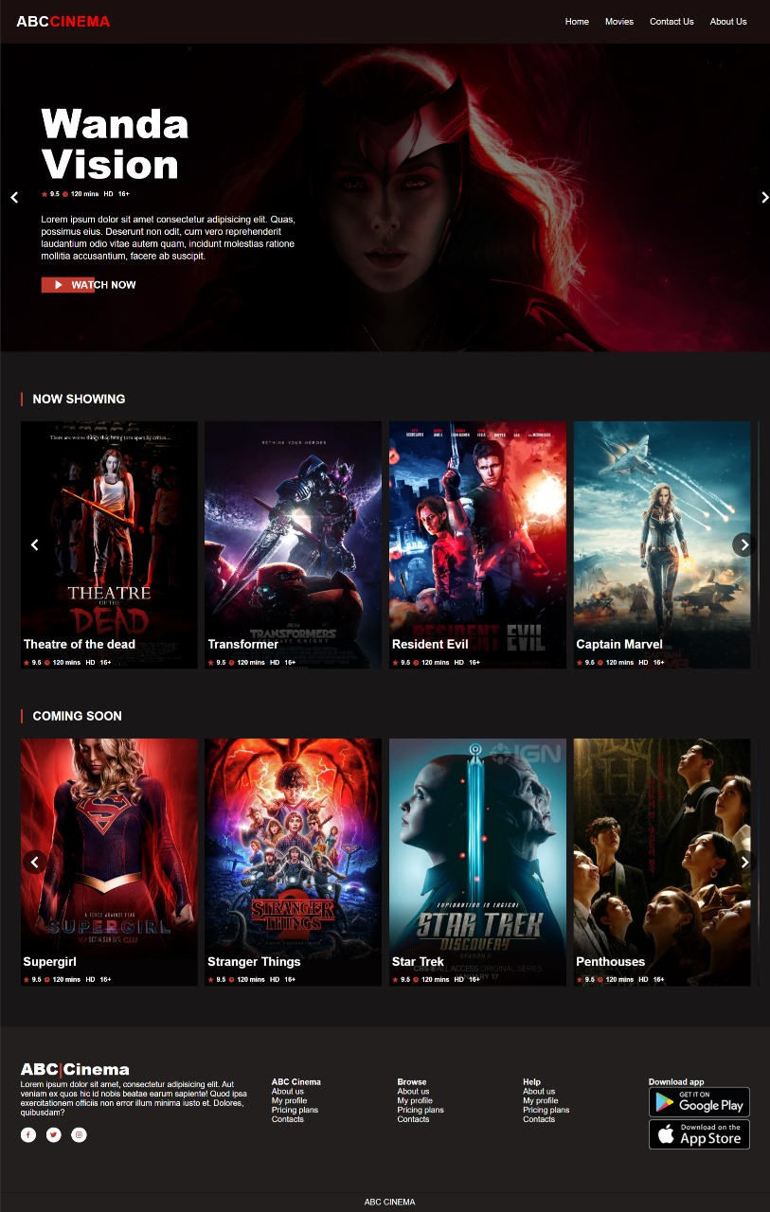
Home Page
Online movie seat booking website using Java Servlet, Apache Tomcat, and MySQL Workbench.
Worked on the home.jsp, the main dashboard page
Used CSS for a clean, responsive design.
Create a simple, user-friendly interface

Slide 8
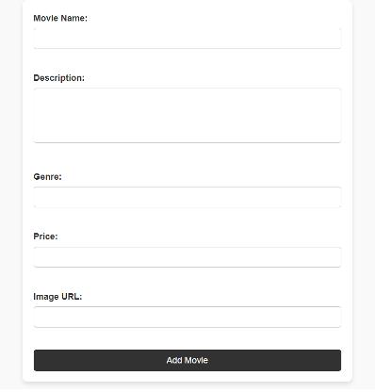
Admin panel page and Add Movie Page
Dynamic Content – The JSP form allows admins to add movies dynamically to the system.
Form Validation – Fields like movie name, description, genre, price, and image URL are required for submission.
Backend Integration – Form data is submitted to AddMovieServlet via the POST method for database storage.
Navigation - Includes a link to the home page and admin panel for smooth user experience.

Slide 9
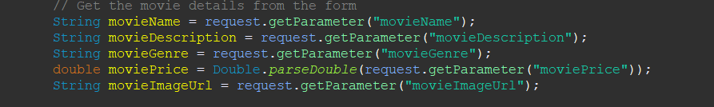
ADD MOVIE PAGE
Form Data Retrieval – The request.getParameter() method captures input values from the form fields like movie name, genre, price, and image URL.
Data Conversion – The Double.parseDouble() method converts the movie price from a string to a double for numerical operations
Database Connection Setup – The JDBC driver is loaded using Class.forName(), and a connection to the abc _cinema database is established using DriverManager.getConnection().

Slide 10
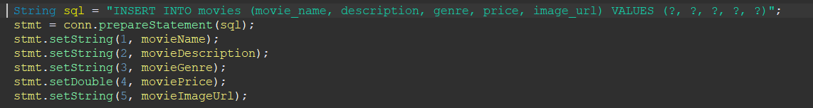
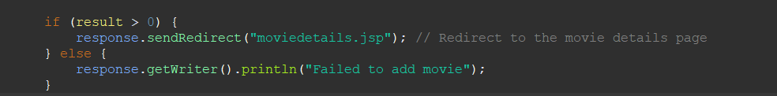
ADD MOVIE PAGE
Parameterized Query – The INSERT statement uses palceholders to prevent SQL injection and safely insert data into the database.
Data Binding – Values for movieName, movieDescription, movieGenre, moviePrice, and movieImageUrl are set using setString and setDouble methods.
Conditional Redirection – Redirects the user to moviedetails.jsp on successful insertion; otherwise, displays an error message indicating the operation failed.

Slide 11
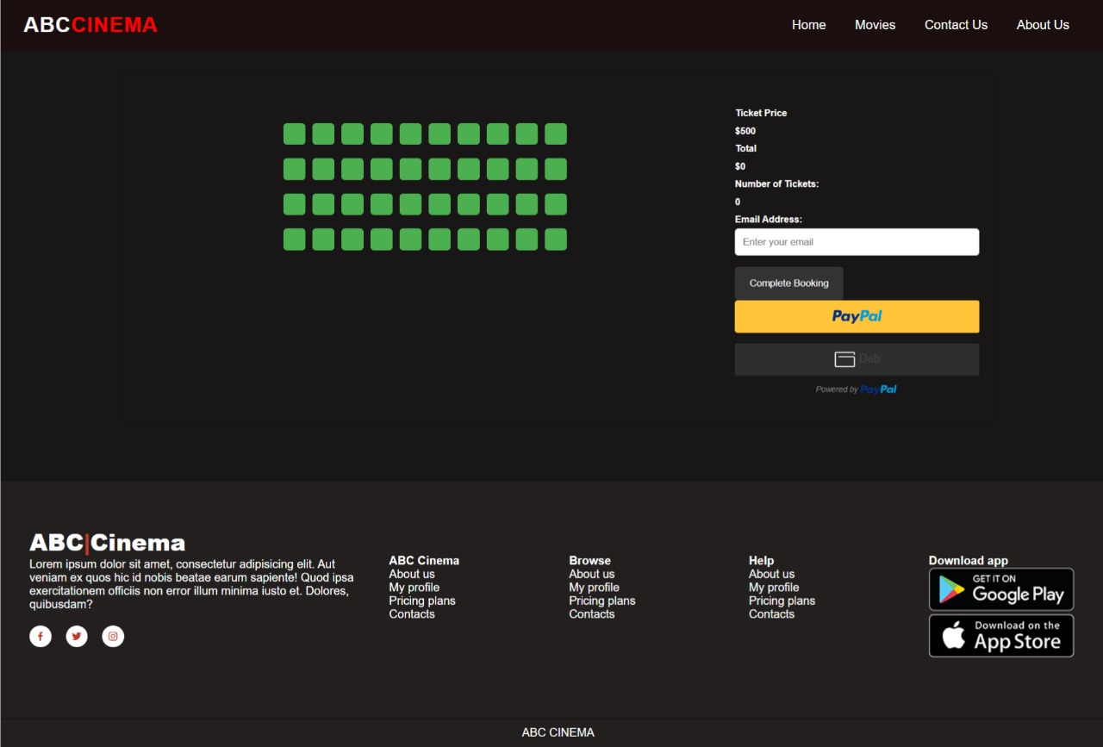
SEAT BOOKING PAGE
Interactive Seat selection – Users can select or deselect seats with real-time visual updates
Dynamic Price calculation – Total ticket price updates instantly based on seat selection.
Clear Movie Information – Displays movie poster, title, genre and description for a user-friendly experience.
Seamless Payment Integration – Integrated PayPal button ensures secure and easy online payments.
Responsive and clean Layout – Modern design optimized for desktop and mobile devices using grid and flex layouts.

Slide 12

Payment Gateway
The PayPal JavaScript SDK is loaded in the <head> section. It uses the client ID and Currency.
This includes the PayPal client library, enabling the rendering of the PayPal button and handling transactions.
The PayPal button is rendered dynamically inside a container.

Slide 13
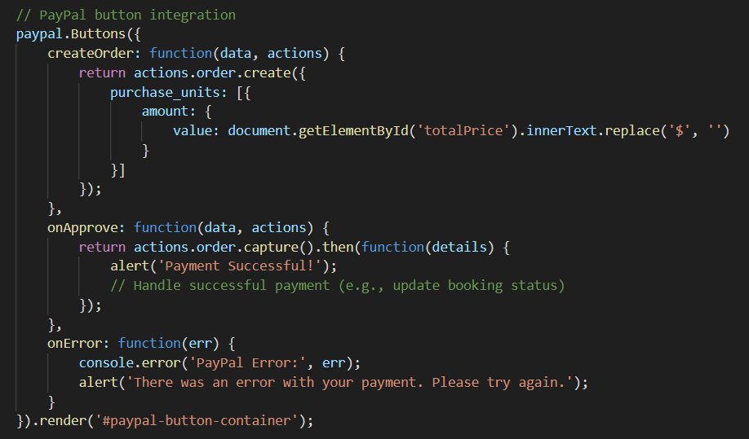
createOrder – Creates a new order with the purchase amount taken from the total price in the total price
onApprove – Handles successful payments and captures the order, displaying a success message.
onError – Handles any errors during the transaction and alerts the user.

Slide 14
PAYMENT SERVLET
Parameter Extraction: Retrieves the movie_id parameter passed from the client (URL or form).
Conversion: Converts the parameter to an integer to use it in the SQL query.
JDBC Connection: Establishes a connection to the abc_cinema database using the MySQL JDBC driver.
Credentials: Utilizes root as the username and 12345678 as the password to connect to the database.

Slide 15
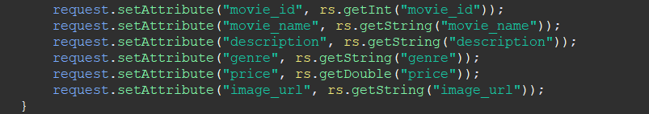
PAYMENT SERVLET
Parameterized Query: Prevents SQL injection by using placeholders (?) instead of directly inserting variables into the query.
Data Retrieval: Executes the query to fetch details of the specific movie based on the movie_id.
Result Handling: Extracts movie details like movie_name, description, genre, etc., from the ResultSet.
Attribute Passing: Stores the movie details as request attributes to make them accessible in the checkout.jsp page.

Slide 16
CONFIRM BOOKING SERVLET
Request Forwarding: Forwards the request and response objects to the checkout.jsp page for rendering.
Separation of Concerns: Ensures that business logic (servlet) is separate from the presentation layer (JSP).

Slide 17

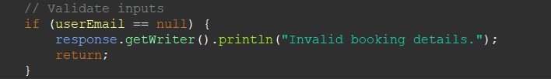
CONFIRM BOOKING SERVLET
This line retrieves the user's email address from the request parameters. This is a critical part of the booking process, as the email is used to send the booking confirmation.
This snippet checks if the email is provided in the request. If not, it returns an error message, ensuring that the booking process doesn't proceed with missing information.

Slide 18

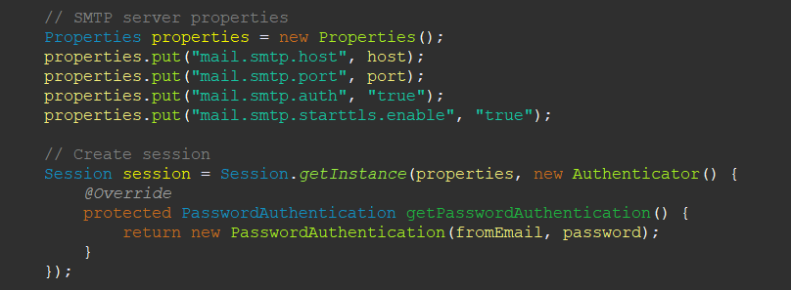
CONFIRM BOOKING SERVLET
Calls the sendConfirmationEmail() method, which sends an email to the user with their booking details. If the email is sent successfully, the method returns true; otherwise, it returns false.
Configures the SMTP properties and authenticates with the email server using the provided email credentials. This ensures secure and reliable email sending.

Slide 19
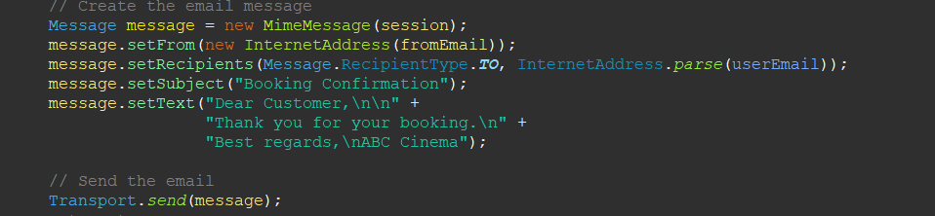

CONFIRM BOOKING SERVLET
Creates the email message with a subject and body, and then sends it to the user's email. This gives users a formal and friendly booking confirmation.
Catches any MessagingException that may occur during the email sending process, logs the error for troubleshooting, and returns false to indicate the failure of the email sending operation.

Slide 20
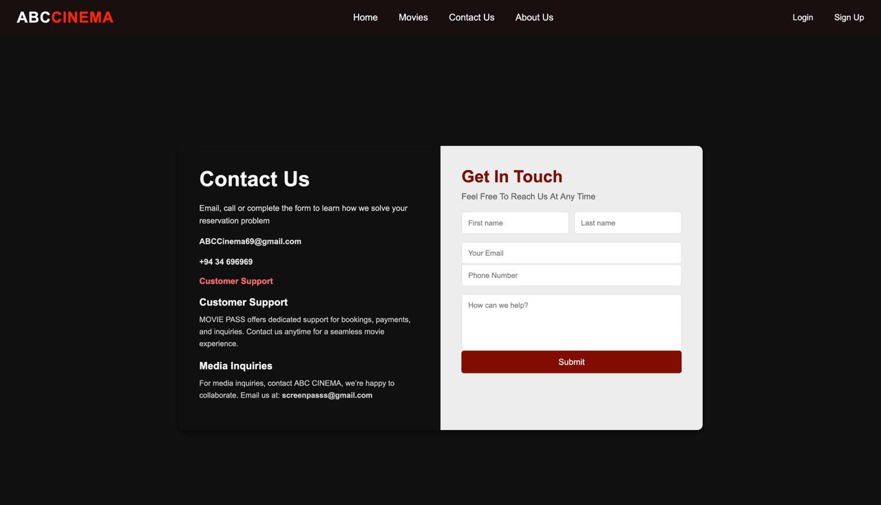
CONTACT US PAGE

